Slide 1

2016 International Traditional Archery Festival
Serena
Justina
Joanne
Robert

Slide 2
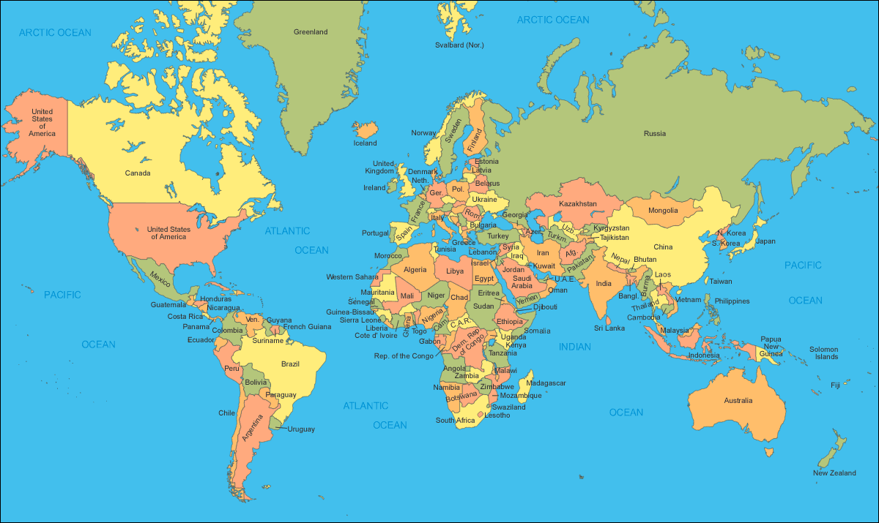
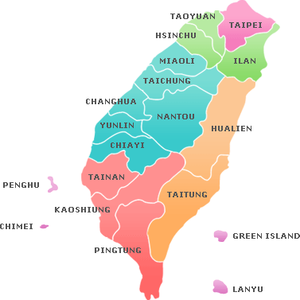

Taichung

Slide 3





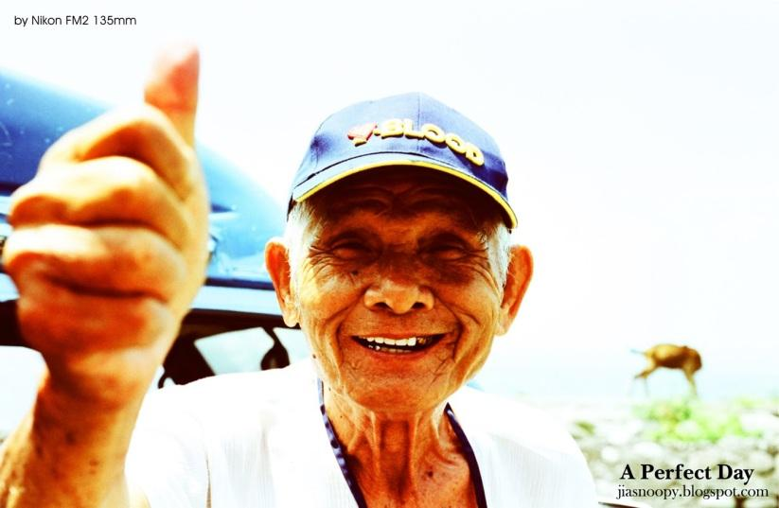
Introduction of Taiwan
The most beautiful scenery in Taiwan is people.
Policy of MICE
Humanistic quality ＆ internationalization

Slide 4
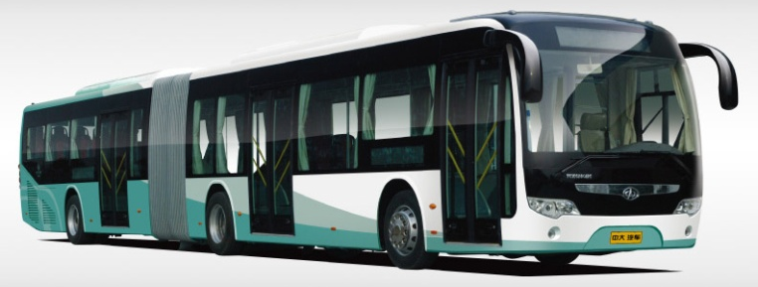

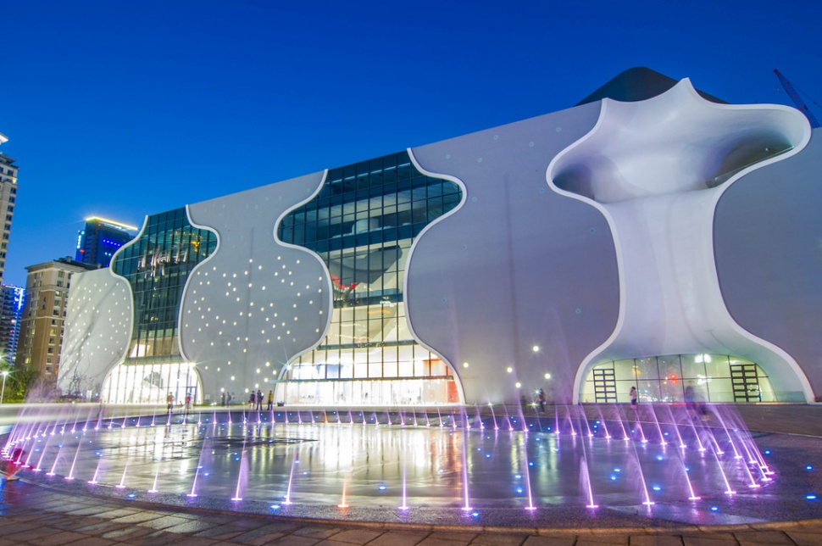
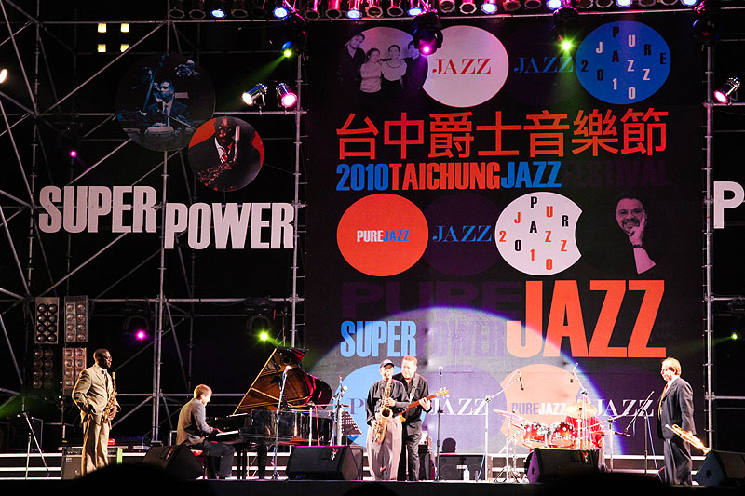
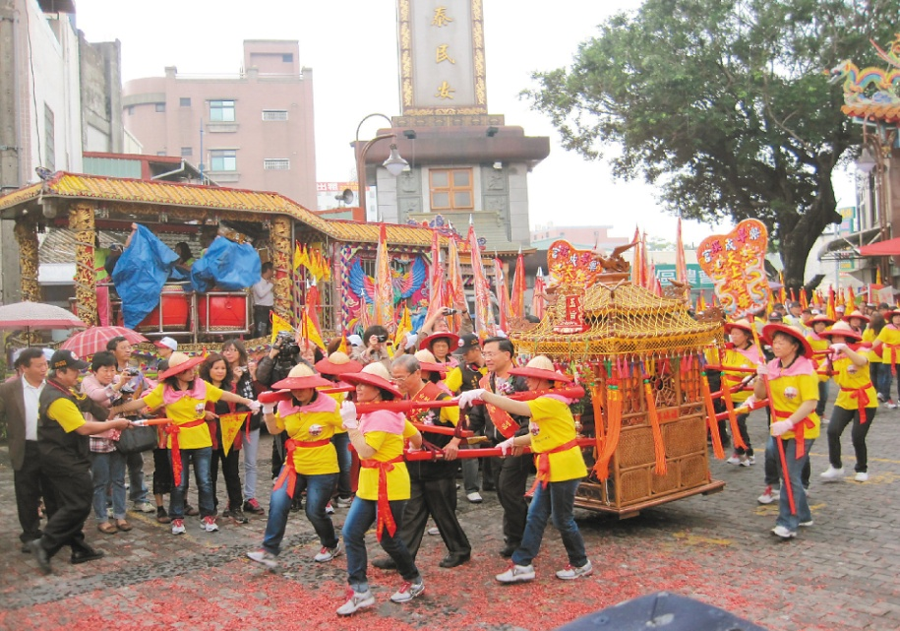
Destination Marketing
Public Transit System
Climate
Lodging
Culture
Tourism Resources

Slide 5



Three Days & Two Nights
The First day
Opening Ceremony (At Fulfillment Amphitheatre)
Take an oath
Opening remarks
Chio-Tian folk drum
Eight-clansman Generals
Taiwanese Aboriginal dancing
Parade (Wenxin Rd.)
Five continents performance
The first Archery competition
Visit Cultural Creativity Tourism Night Market
10:00-10:10
10:10-10:25
10:25-10:35
10:35-11:00
11:00-11:30
11:30-12:00
13:30-15:00
15:00-16:30
16:30-19:30

Slide 6
Three Days & Two Nights
The Second day
The Second Competition
Forum
Free time
Closing Ceremony (At Taichung Metropolitan Opera House)
Highlight Reel
Award Ceremony
Archery Inheritance
Volunteers Sharing
Dancing fountain show
09:00-10:30
10:30-11:30
11:30-16:30
16:30-17:00
17:00-17:20
17:20-17:40
17:40-18:00
18:00-18:30

Slide 7
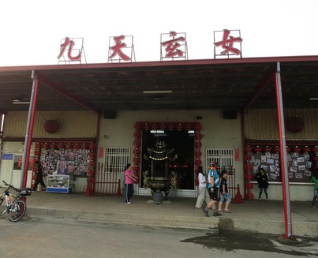
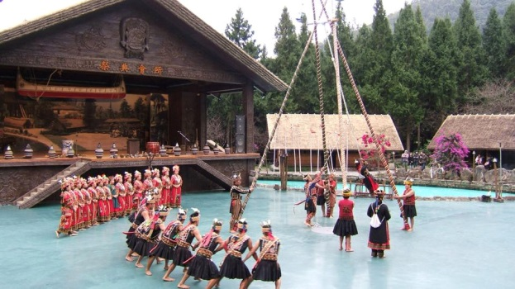
Three Days & Two Nights
The Third day
Incentive Travel
Chio Tian Temple
Formosan Aboriginal Culture Village and Sun Moon Lake
10:00-13:30
13:30-18:00

Slide 8

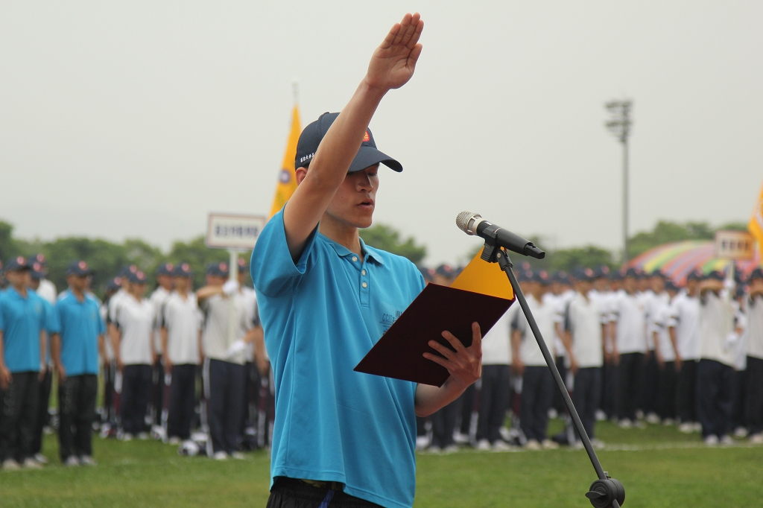

Opening Ceremony
01
02
01
Take an oath
02
Opening remarks

Slide 9
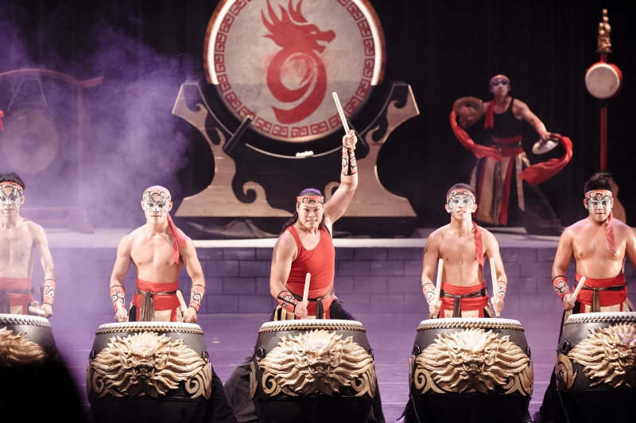
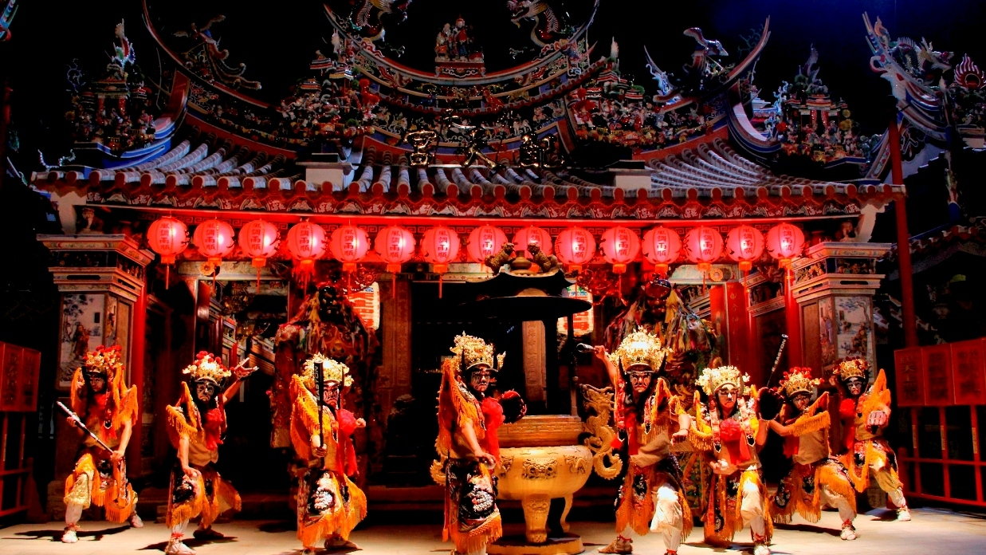
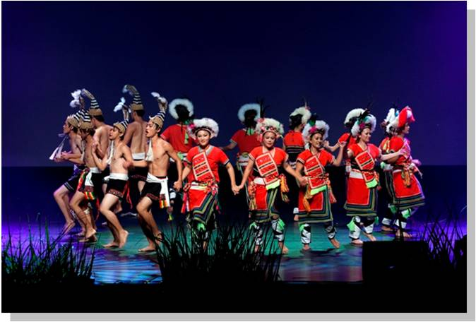
01
Chio-Tain Folk Drum
02
Eight-clansman Generals
03
Native Art :
Aboriginal dancing

Slide 10
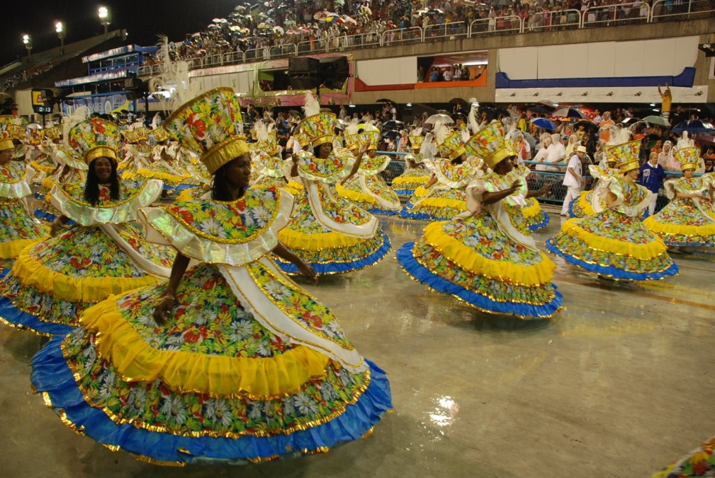
Parade
01
Form: Carnival
02
March by the main roads
03
Attract crowds & media

Slide 11



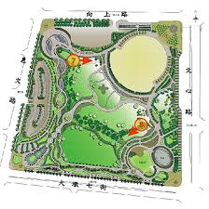
PARADE
Route: Contestants are split into A team and B team
Gongyi Road Sec 2
Meet
Henan Road Sec 4
Huiwen Road
Start
Huizhong Road Sec 3
Liming Road Sec 2
Xiangshang Road Sec2
Wenxin Road Sec 1
Wuquan West Road Sec2

Slide 12




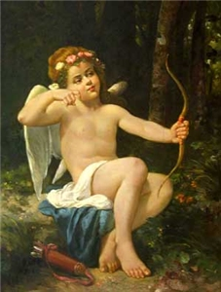
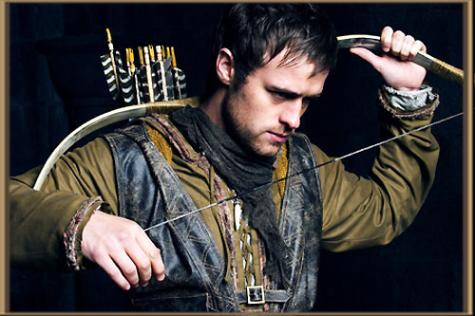
PARADE
Theme: Five continents
Europe
Robin Hood
Cupid
All participants wear representative
costumes.
Topic： Myth of archery
Fairy tales

Slide 13
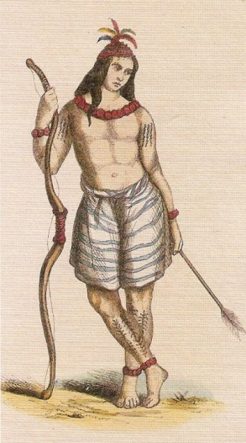
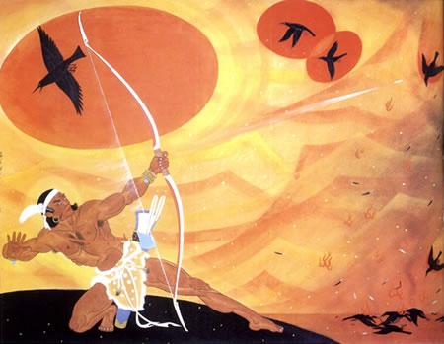
PARADE
Theme: Five continents
Europe
Hou Yi
Aborigine

Slide 14
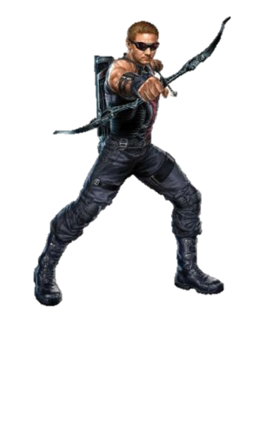
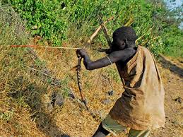
PARADE
Theme: Five continents
Europe
America - Hawkeye
Africa - African hunter

Slide 15
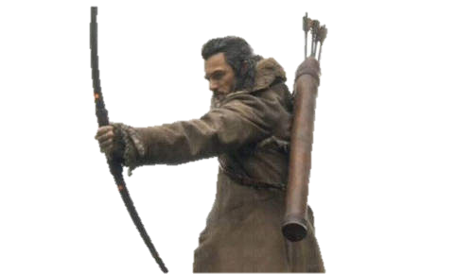
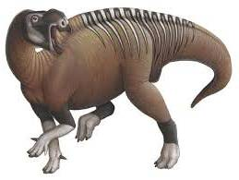
PARADE
Theme: Five continents
Oceania - Marksman

Slide 16

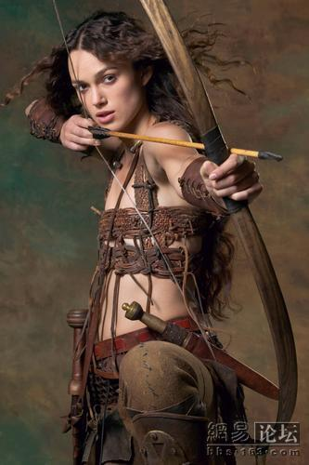
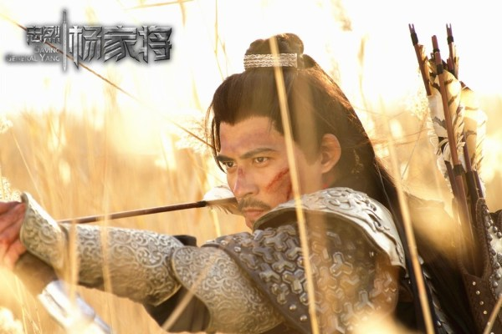
Competition
All contestants from each country should wear
traditional costumes.
Asia
America

Slide 17
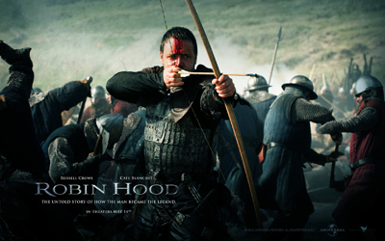
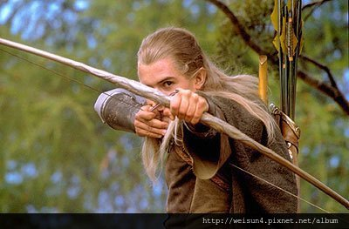
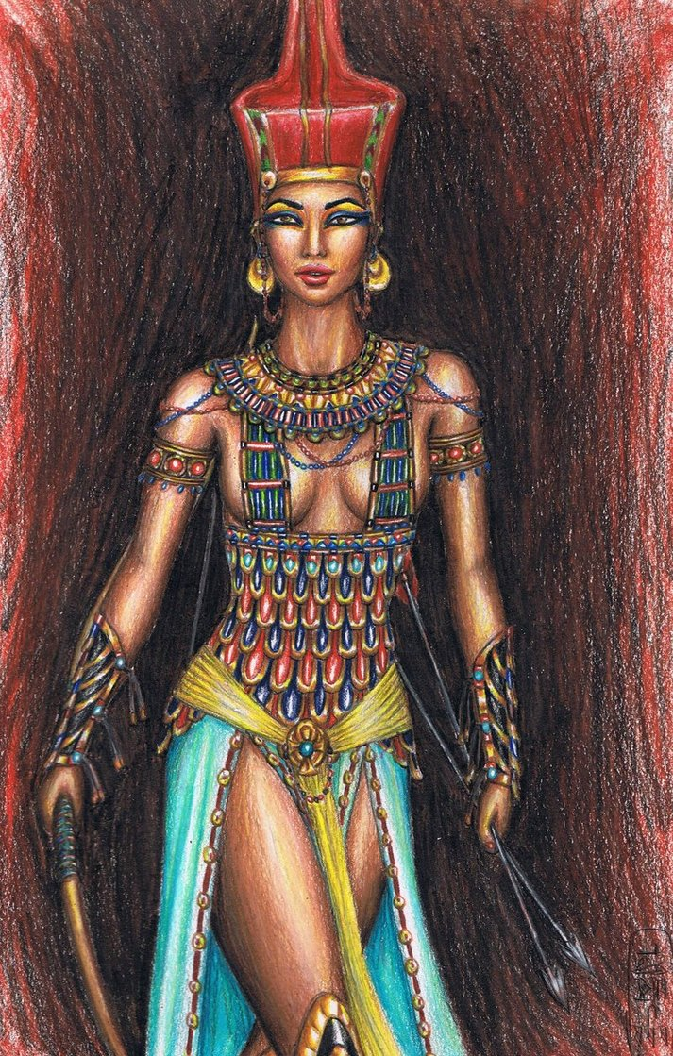
Competition
Europe
Oceania
Africa

Slide 18
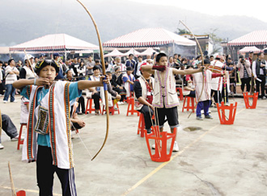
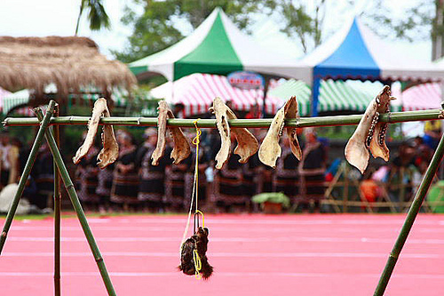
Competition Mode One
Scoring
1
Moving target
Scoring
2
Motionless target
Scoring
3
How large the target is
Scoring
4
The distance from the target

Slide 19



Competition Mode two
Object Shooting
Three people from each team attend this competition with 10 arrows.
Scoring system: shoot at frisbees that are thrown up into the air and count shot-down numbers in total.

Slide 20
Forum
Topic
How to promote International
Traditional Archery.
03
Options
01
Host
President of WA Chinese Taipei
Options
Keynote speakers
President & Vice President of AAF CONGRESS
Vice President of WA Chinese Taipei
President of Sport Administration
02
Options
04
Options
Options
Participants
All competitors are welcomed.

Slide 21
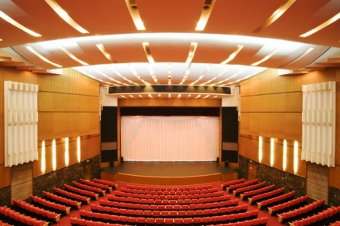

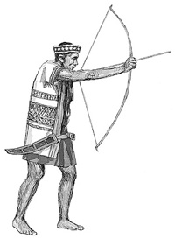

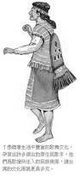
Closing Ceremony
Highlight
Reel
Awarding
Ceremony
01
02
02
02
04
02
03
Archery
Inheritance
Volunteer
Sharing

Slide 22

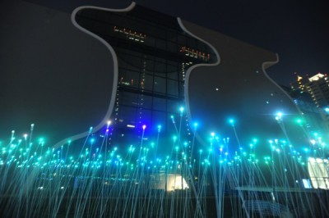
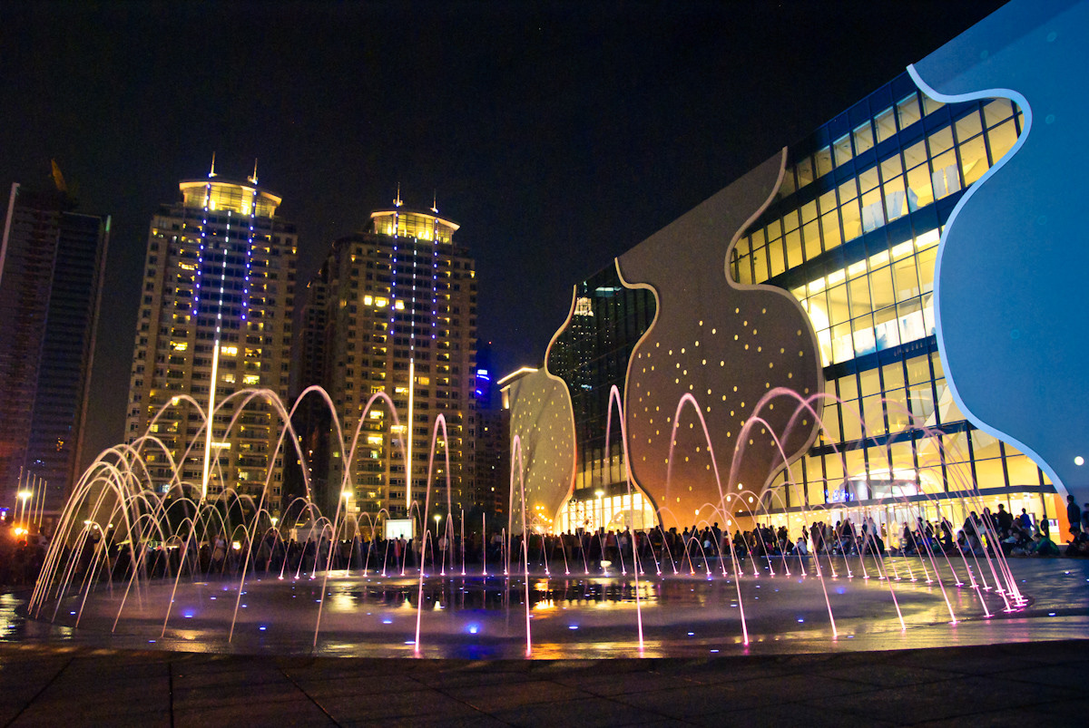

Closing Ceremony
Dancing Fountain Show

Slide 23
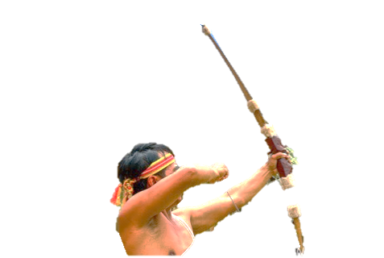


Trophy
The cup -
both arms hold the bow
A Hundred-pace
snake totem
Stand for the aborigines
in Taiwan
Embedded on the arm

Slide 24

A snake winds around a bow-shape circle and a arrow traverses it.
Pin
Souvenir

Slide 25
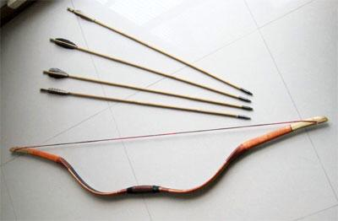
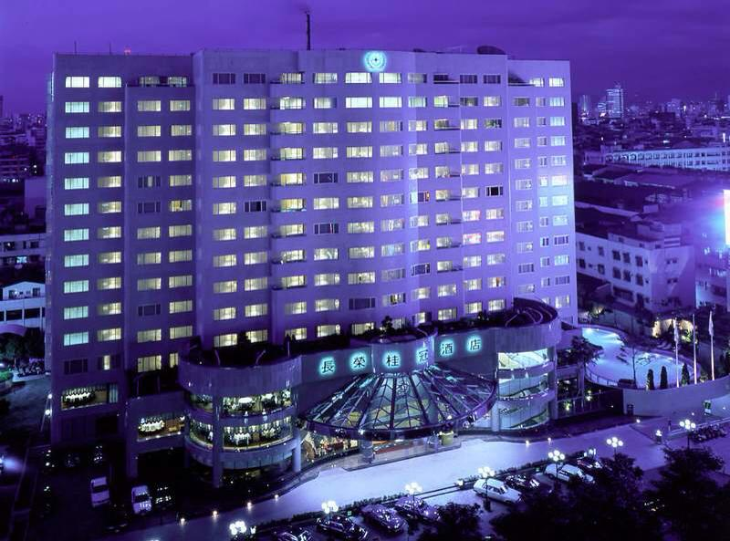
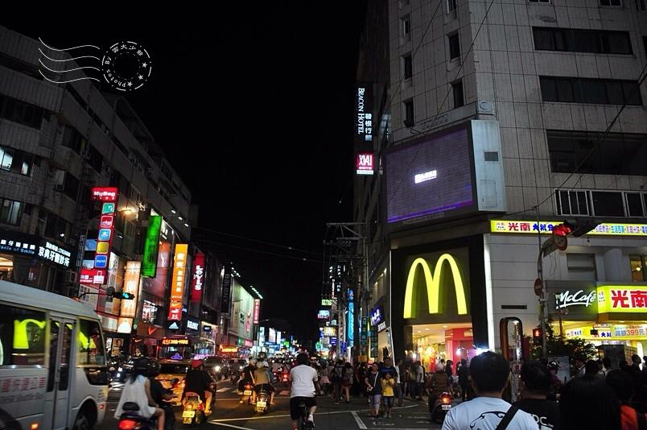

I n d u s t r y
Economic Benefits
Advance archery industrial development.
Promote tourism industrial development.
Boost commercial and economic opportunities.
Archery
Tourism
Shopping

Slide 26
Budget Planning Form
 |  | Item | Unit price | Quantities /unit | Amount (TWD)
 | Affairs | Site rental |  |  | 200,000
 |  | Booth |  |  | 50,000
 |  | Advertising |  |  | 100,000
 |  | Apparel allowance | 800 | 200 | 160,000
 |  | Travel | 20,000 | 5 | 100,000
 |  | souvenir | 1,000 | 250 | 250,000
 |  | Activity & competition |  |  | 200,000
 |  | Lodging | 3,000 | 200 | 600,000
 | Personnel | Board | 600 | 250 | 150,000
 |  | Transportation |  |  | 100,000
 |  | Utility |  |  | 5,000
 |  | Postage/cable |  |  | 5,000
 |  | Miscellaneous |  |  | 20,000
 |  | Educational training | 1,000 | 50 | 50,000
 |  | Audition |  |  | 10,000
 | Total |  |  |  | $2,000,000

Slide 27
Organizational Structure
Activity planning
Public relations
VIP invitation
Purchasing
Purchasing
General affairs
A/V equipment
Transportation
VIP pick-up
Planning
Flow of activity
Forum
Propaganda
Media campaign
Reception
Room and Board
Cancellation after verification
Equipment repairing
Transportation arrangement
Parking lot arrangement

Slide 28
Gantt Chart
Month / 2015 Items | 1 | 2 | 3 | 4 | 5 | 6 | 7 | 8 | 9 | 10 | 11 | 12 | 2016 1
Design of activities
Arrangement of activities
Time allocation
Registration
Equipment production
Souvenir production
Site rental
Site setting
Route planning
Reservation of road use
Hotel arrangement
Transportation planning
Incentive travel planning
Reservation of Incentive travel
Rehearsal
Execution

Slide 29
Thank You !
Q & A

